Slide 1
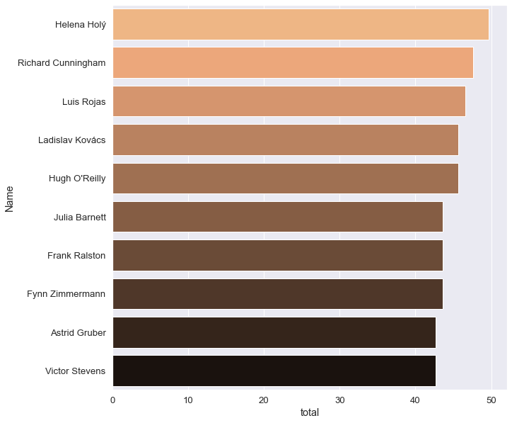
Question 1: Who is the best customer?
<visualization>
Top 10 customers who spent the most money across all of the dataset

Slide 2
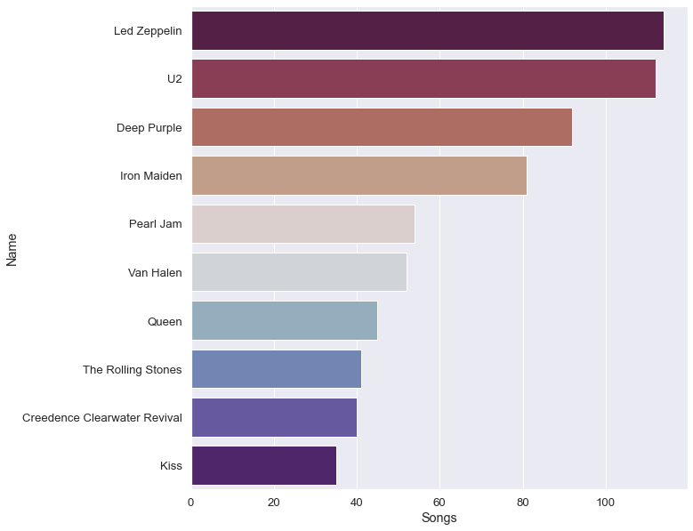
Question 2: Who writes the most rock music?
<visualization>
the top 10 artists who have written the most rock music in our dataset.

Slide 3
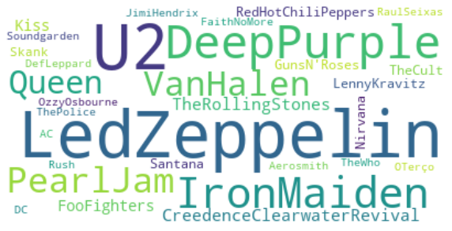
Q2 cont: Who writes the most rock music?
<visualization>
Word Cloud of top 30 artists who have written the most rock music in our dataset.

Slide 4
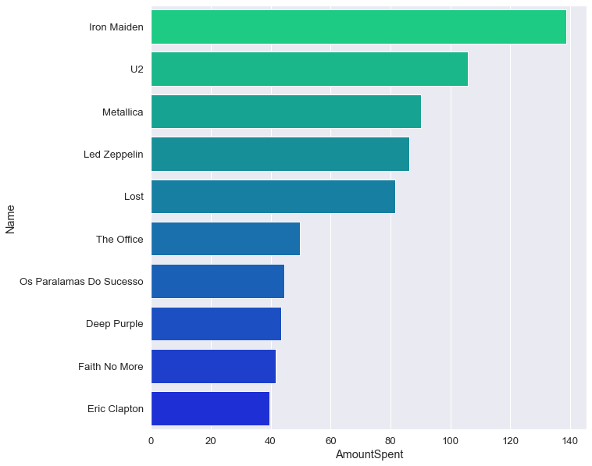
Question 3: The top artists that make the most amount of revenue
<visualization>
Top 10 artists according to total invoice amounts in our dataset

Slide 5
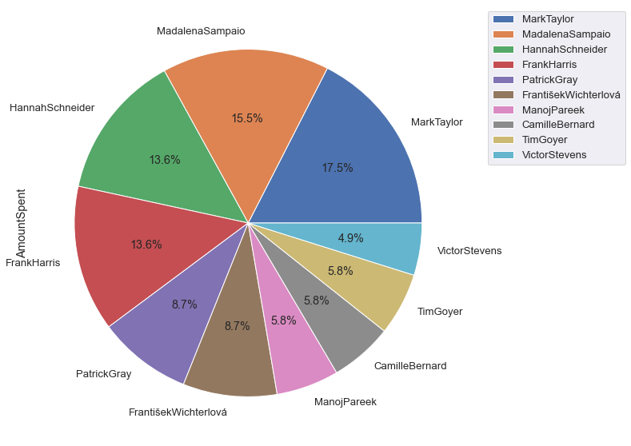
Question 4: the top fans for the Iron Maiden?
<visualization>
the top 10 purchasers using invoice amount for the top Artist In our dataset Iron Maiden.

